Slide 1
The Client Software Examples
Shyan-Ming Yuan
CS Department, NCTU
smyuan@gmail.com

Slide 2
The UDP Client Algorithm
Find the IP address and port number of the desired server by
  gethostbyname()+ getservbyname()+ getprotobyname() or
  getaddrinfo()
Allocate a socket by
  socket(AF_INET, SOCK_DGRAM, 0)
Let UDP arbitrary select an unused port on the local host.
Set the socket to a single dedicated remote server by
  connect() and
  send()+recv() or write()+read() to communicate with the server.
When the udp socket needs to communicate with multiple servers,
  sendto() and recvfrom() should be used to communicate with these servers.
Deallocate the socket by
  close() or shutdown()

Slide 3
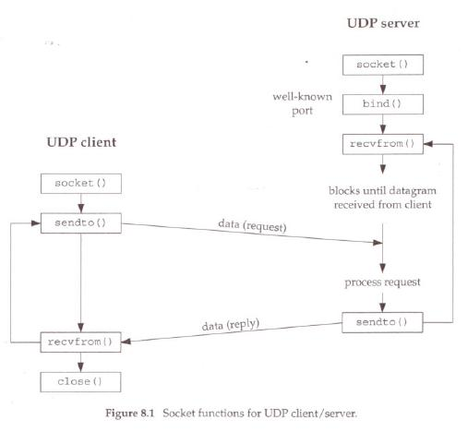
The UDP Client Server Paradigm
Unconnected Mode
gethostbyname
getservbyname
getprotobyname
getaddrinfor

Slide 4
IP address and Port number by gethost(serv/proto)byname
struct sockaddr_in sin; /* struct for holding IP address */
memset(&sin, 0, sizeof(sin));
sin.sin_family = AF_INET;
struct hostent *phe; /* pointer to host information entry */
phe = gethostbyname(host); /* host contains domain name of the server */
memcpy(&sin.sin_addr, phe->h_addr, phe->h_length);
sin.sin_addr.s_addr = inet_addr(host); /* host contains dotted-decimal IP */
struct servent *pse; /* pointer to service information entry */
pse = getservbyname(service, transport); /* service name & protocol name */
sin.sin_port = pse->s_port;
sin.sin_port=htons((unsigned short)atoi(service)); /* stringed port number */
struct protoent *ppe; /* pointer to protocol information entry*/
ppe = getprotobyname(transport); /* “udp” or tcp” */

Slide 5
Exchange Messages by sendto and recevfrom
int sfd; /* socket descriptor */
sfd=socket(AF_INET, SOCK_DGRAM, ppe->p_proto);
socklen_t sin_addrlen; /* address length of sin */
sin_addrlen = sizeof(sin);
size_t len;
ssize_t nread, nchars;
char buf[BUF_SIZE];
while (fgets(buf, sizeof(buf), stdin)) { /* get data from stdin */
len = strlen(buf);
if (len == 1) exit(0);
// send data to the server addressed by the sin
nchars = sendto(sfd, buf, len, 0, (struct sockaddr *)&sin, sin_addrlen);
// receive echo back from the server
nread = recvfrom(sfd, buf, BUF_SIZE, 0, (struct sockaddr *)&sin, &sin_addrlen);
}

Slide 6
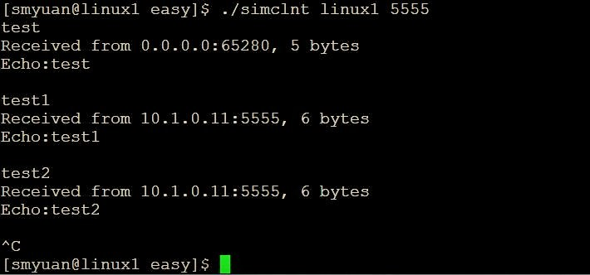
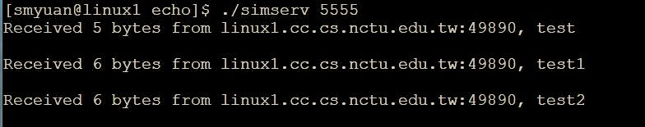
Simple UDP Echo Service
Client
Server

Slide 7
The getaddrinfo function call
#include <sys/types.h>
#include <sys/socket.h>
#include <netdb.h>
int getaddrinfo(const char *restrict hostname, const char *restrict servname,
const struct addrinfo *restrict hints, struct addrinfo **restrict res);
void freeaddrinfo(struct addrinfo *res);
On success, 0 is returned, otherwise error codes are returned. The gai_strerror() function can be used to translate error codes to a human readable string, suitable for error reporting.
The getaddrinfo() returns one or more addrinfo structures, each of which contains an Internet address that can be used in the bind() or connect() system calls.
  The hostname and servname specify an Internet host name and a standard network service name.
  The hints points to an addrinfo structure that specifies criteria for selecting the socket address structures returned in the list pointed to by res. The list is dynamically allocated and initialized by the getaddrinfo().
The freeaddrinfo() frees the memory that was allocated for the dynamically allocated linked list res.

Slide 8
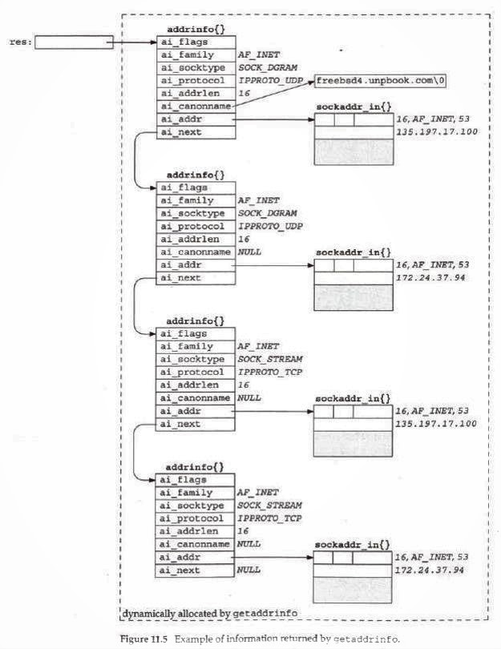

Slide 9
The UDP Client Server Paradigm
Pseudo Connection mode
Client
Server
socket
socket
gethostbyname
getservbyname
getprotobyname
getservbyname
getprotobyname
Pseudo Connection
connect
bind
write/send
recvfrom
read/recv
sendto

Slide 10
The connectsock() function
int connectsock(const char *host, const char *service, const char *transport ){
// host - name of host to which connection is desired
// service - service associated with the desired port
// transport - name of transport protocol to use ("tcp" or "udp")
struct sockaddr_in sin; /* an Internet endpoint address */
int s, type; /* socket descriptor and socket type */
memset(&sin, 0, sizeof(sin));
sin.sin_family = AF_INET;
// use gethostbyname+getservbyname+getprotobyname to set sin
if (strcmp(transport, "udp") == 0) type = SOCK_DGRAM;
else type = SOCK_STREAM;
s = socket(PF_INET, type, ppe->p_proto);
if (s < 0) errexit("can't create socket: %s\n", strerror(s));
if (connect(s, (struct sockaddr *)&sin, sizeof(sin)) < 0)
errexit("can't connect to %s.%s: %s\n", host, service, strerror(errno));
return s;
}

Slide 11
The connectUDP and connectTCP
connectUDP(host, service, “udp”): connect to a UDP server
  int connectUDP(const char *host, const char *service ) {
  return connectsock(host, service, "udp");
  }
connectTCP(host, service, “tcp”): connect to a TCP server
  int connectTCP(const char *host, const char *service ) {
  return connectsock( host, service, "tcp");
  }
errexit: print an error message and exit

Slide 12
The passivesock() function
int passivesock(const char *service, const char *transport, int qlen ){
// service - service associated with the desired port
// transport - name of transport protocol to use ("tcp" or "udp")
// qlen - maximum server request queue length
struct sockaddr_in sin; /* an Internet endpoint address */
int s, type; /* socket descriptor and socket type */
memset(&sin, 0, sizeof(sin));
sin.sin_family = AF_INET;
sin.sin_addr.s_addr = INADDR_ANY;
// use getservbyname+getprotobyname to set sin
if (strcmp(transport, "udp") == 0) type = SOCK_DGRAM;
else type = SOCK_STREAM;
s = socket(PF_INET, type, ppe->p_proto);
if (s < 0) errexit("can't create socket %s\n", strerror(s));
if (bind(s, (struct sockaddr *)&sin, sizeof(sin)) < 0)
errexit("can't bind to %s port: %s\n", service, strerror(errno));
if (type == SOCK_STREAM && (errno=listen(s, qlen)) < 0)
errexit("can't listen on %s port: %s\n", service, strerror(errno));
return s;
}
/* connectUDP - connect to a specified UDP service on a specified host
*/
int connectUDP(const char *host, const char *service )
/*
* Arguments:
* host - name of host to which connection is desired
* service - service associated with the desired port
*/
{
return connectsock(host, service, "udp");
}

Slide 13
The passiveUDP and passiveTCP
passiveUDP(const char *service): create a passive socket for use in a UDP server
  int passiveUDP(const char *service ) {
  return passivesock(service, "udp", 0);
  }
passiveTCP(service, int qlen): create a passive socket for us in a TCP server
  int passiveTCP(const char *service, int qlen) {
  return passivesock( service, "udp", qlen);
  }
errexit: print an error message and exit

Slide 14
The TCP Client Algorithm
Find the IP address and port number of the desired server by
  gethostbyname()+ getservbyname()+getprotobyname() or
  getaddrinfor()
Allocate a socket by
  socket(AF_INET, SOCK_STREAM, 0)
Let TCP arbitrary select an unused port on the local host.
Connect the socket to the remote server by
  connect()
Use send()+recv or write()+read() to communicate with the server.
Deallocate the socket by
  close() or shutdown()

Slide 15
The TCP Client Server Paradigm
Client
Server
socket
socket
bind
listen
connect
accept
Connection request
generate a new socket
write/send
request
conn socket
read/recv
read/recv
response
write/send

Slide 16
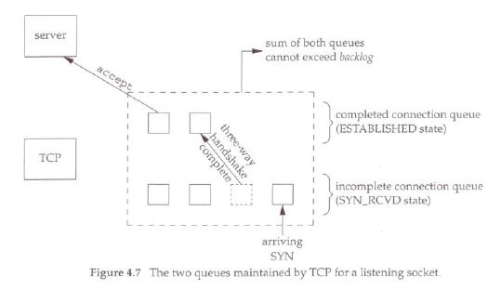
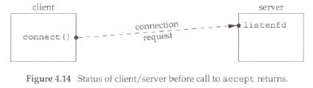
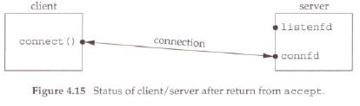
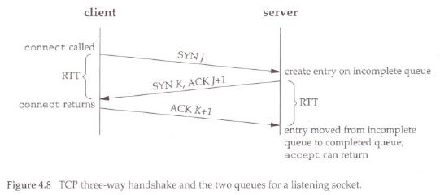

Slide 17
Some Important Facts
In UDP socket, a receiver uses recvfrom() to retrieve the whole message received.
In TCP socket, a receiver uses read()/recv() to retrieve a specified number of bytes from the byte stream associated with the socket.

Slide 18
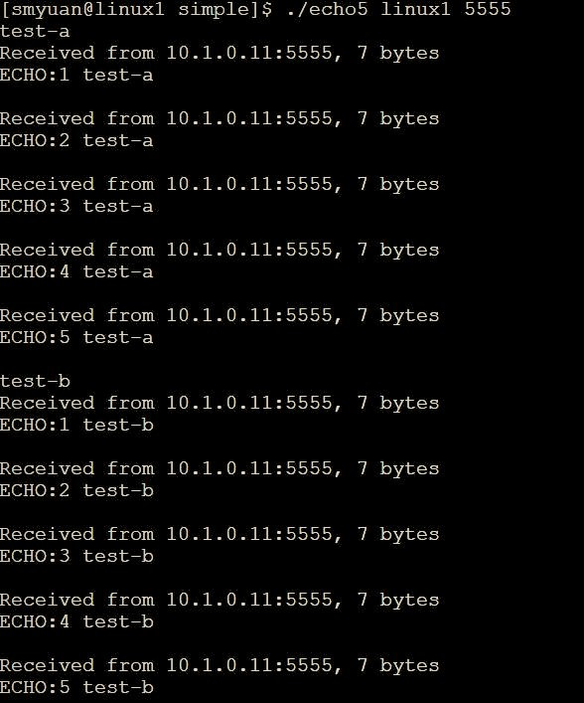
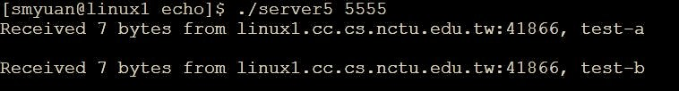
UDP Echo 5
UDP echo5 client
UDP echo5 server

Slide 19
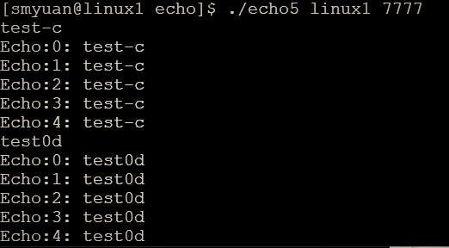
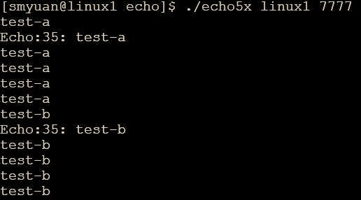

TCP Echo 5
TCP echo5 client
TCP echo5x client
TCP echo5 server

