Slide 1
Management of Server Concurrency
Shyan-Ming Yuan
CS Department, NCTU
smyuan@gmail.com

Slide 2
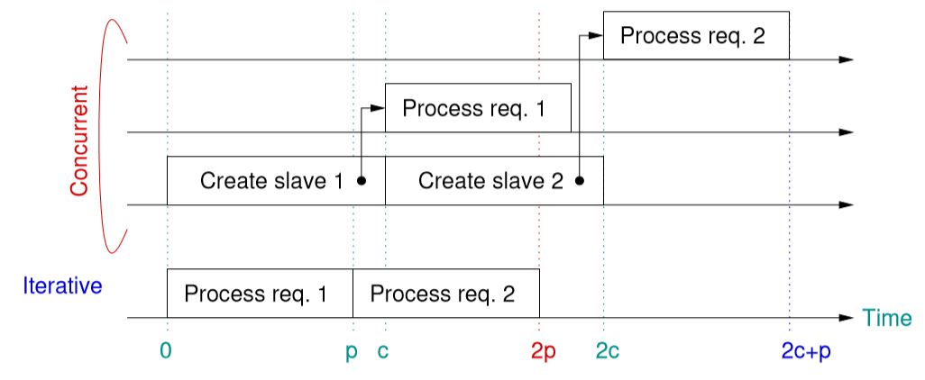
Motivations
The choice between iterative and concurrent implementation of a server is not trivial.
  Although a concurrent server can handle several requests simultaneously, it requires extra overhead of creating new process (or threads.)
  In some situations, it is preferred to use iterative design.
    In particular, the latency of processing the request is extremely short.

Slide 3
Server Concurrency Management
In general, there are following approaches for managing the level of concurrency for a server.
  The demand-driven approach allows a server to create a new process (or thread) on demand. The concurrency level is therefore bounded by the underlying OS.
  The bounded concurrency approach sets a limitation for the maximum number of concurrent processes (or threads) allowed by a particular server.
    The bounded demand-driven approach allows a server to create a new process (or thread) on demand if the number of concurrent processes is less than the maximum. Otherwise, the new request will be queued and blocked.
    The pre-allocation approach created a predefined fixed number of working processes (or threads) before the server starts to accept requests from clients.

Slide 4
The Bounded Demand-Driven
In posix environment, a semaphore can be used to control the number of existing slave processes (or threads.)
  The semaphore is initialized to the maximum (N)
  Before creating a new slave, the sem_wait() must be called.
  Before a working slave terminates, it must call the sem_post() to allow the server to create a new slave on demand.
In a non-posix environment, if the file lock is supported then a file containing a single integer of N with the file lock can be used to simulate the semaphore.
  Before creating a new slave, the server must lock the file and decrease its current value by 1 if it is greater than 0.
  Before a working slave terminates, it must lock the file and increase its current value by 1.

Slide 5
Pre-Allocation in Linux
In Linux, if a socket is shared by multiple processes (or threads,) then all accept() calls to the socket are guaranteed to be mutually exclusive.
  Only one process (or thread) will be unblocked and returned from the accept call at a time.
Similarly, the recv_from() also has this mutual exclusive property.
Thus, in Linux, a master can open and bind a socket to the well known port before it creates slaves to achieve pre-allocation.

Slide 6
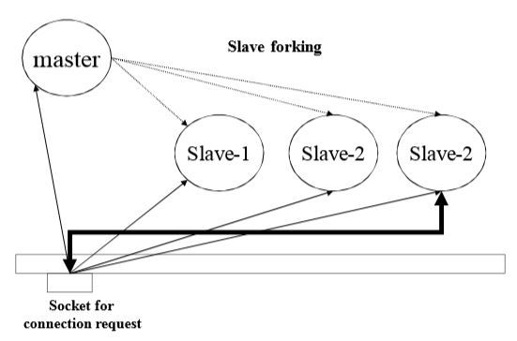
The Pre-Allocation for UDP Servers
Recvfrom()
N
…
Recvfrom()
Recvfrom()
Recvfrom()
sendto()
recvfrom()
Socket for the well-known port

Slide 7
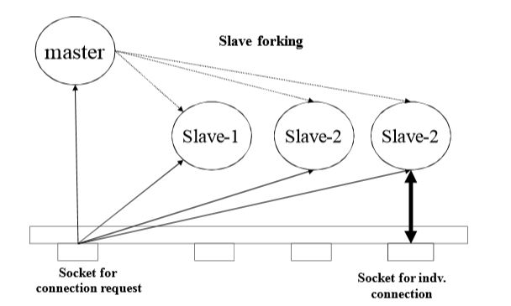
The Pre-Allocation for TCP Servers
accept()
N
…
accept()
accept()
accept()
recv()
send()

Slide 8
The Delayed Slave Allocation
In general, the actual processing latency of a request may not be available in advance.
  It may be difficult to make the choice between iterative and concurrent in the design phase.
  Thus, delayed slave allocation is proposed to avoid to make the decision until the execution time.
In delayed slave allocation approach, a server starts processing each request iteratively until a predefined time limit is expired.
  The server then creates a concurrent slave to handle the remaining part of the request.
  This delay allows a server to check for errors and handle short requests before it creates a new slave.

Slide 9
The Delayed Slave Servers
In Linux, an alarm can be used to set a time limit such that the server can arrange a signal handling function that will creates a new slave when the timer expires.
  The master then jump back to accept a new connection.
pid_t pid, mpid; /* master pid and worker pid */
int msock; /* master server socket */
int ssock; /* slave server socket */
jmp_buf JumpBuffer; /* buffer for recorded stack */
void reaper(int sig)
{ signal(sig, SIG_IGN); // disable interrupt
switch (pid=fork()){
case -1: printf("Failed to fork: %s\n", strerror(errno)); // parent continue as a worker
case 0: return 0: // slave as a worker
default: close(ssock); // parent jump to accept new connection
(void) signal(SIGALRM, reaper); // enable the interrupt again
(void) signal(SIGCHLD, reaper1);
longjump(JumpBuffer, 1);
}
}

Slide 10
The new main()
int main(int argc, char *argv[])
{ char *service = "7451"; /* service name or port number */
struct sockaddr_in fsin; /* the address of a client */
unsigned int alen; /* length of client's address */
(void) signal(SIGCHLD, reaper1);
(void) signal(SIGALRM, reaper);
msock = passiveTCP(service, QLEN();
mpid = getpid(); /* record pid of the master */
while (1) {
alen = sizeof(fsin);
if (setjump(JumpBuffer) == 0){ // save the current state in JumpBuffer
ssock = accept(msock, (struct sockaddr *)&fsin, &alen);
if (ssock < 0) {
if (errno == EINTR) continue; errexit("accept: %s\n", strerror(errno));
}
TCPechod(ssock);
}
}
}

Slide 11
The new TCPechod()
int TCPechod(int fd)
{ char buf[BUFSIZ];
int cc, i, n;
pid = getpid(); // pid is global, parent as a worker
(void) alarm(1); // set the timer
n = rand()%1000+1;
for (i=0; i< n*100000; i++) // simulate unknown processing time
sum = sum+i;
while (cc = read(fd, buf, sizeof buf)) {
if (cc < 0){
if (pid==0) // slave read error
errexit("echo read: %s\n", strerror(errno)); printf("echo read: %s\n", strerror(errno));
break; // parent as worker read error
}
if (write(fd, buf, cc) < 0){
if (pid==0) // slave write error
errexit("echo write: %s\n", strerror(errno)); printf("echo write: %s\n", strerror(errno));
break; // parent as worker write error
}
}
close(fd);
if (pid==0) exit (0); // slave terminate itself
}

Slide 12
The Delayed Pre-Allocation
It is possible to combine both pre-allocation and delayed approaches together.
  A server can start with no pre-allocated slaves and use the delayed allocation mechanism.
  However, once a slave has been created, it will not terminate when its current work completes.
  The slave then can act as a master to accept a next connection.
The problem of delayed pre-allocation is how to manage the maximum number of concurrent processes (or threads).
  One possible approach is to set a maximum propagation value M.
    Each time a process creates a new slave it decrease the M by 1. If M becomes 0 then the process can create no more slave.
  In posix, a semaphore can be used to limit the number of slave processes.

