Slide 1
Concurrency in Clients
Shyan-Ming Yuan
CS Department, NCTU
smyuan@gmail.com

Slide 2
Advantages
Concurrent implementations can separate functionality into conceptually separate components.
Concurrent implementations can be easier to maintain and extend because they make the code modular.
Concurrent clients can contact several servers at the same time:
  Either to compare response times or results
  or to merge the results returned from different servers.
Concurrency can allow the user to change parameters, inquire about the client status, or control processing dynamically.
The key advantage in clients lies in asynchrony.
  It allows a client to handle multiple tasks simultaneously without imposing a strict execution order on them.

Slide 3
Control Functions vs Normal Processing
There is a need to separate control functions from normal processing.
Considers a queries such as: Find all people who live on M Street.
  If the database contains information for a single town, the response might include fewer than 1000 names and takes less than 1 second.
  If the database contains information about all people in a country or even the whole world, the response could take more than 10 minutes.
A user who invokes a client software may have no idea how long it will take to receive a response or how large that response will be.
  If a user becomes impatient to wait, the user has only one option: abort the client program and retry it again later.
An well designed concurrent client can permit the user to continue to interact with the client while the client waits for a response.

Slide 4
Concurrent Contact With Multi Servers
A concurrent client for the TIME service can send a request to multiple TIME servers in the same time:
  accepts the first arrived response
  or takes the average of several responses.

Slide 5
Concurrent Client Implementations
Most concurrent client implementations follow one of two
basic approaches:
  The client divides into two or more threads of execution that each handle one function.
  The client consists of a single thread that uses select to handle multiple input and output events asynchronously.

Slide 6
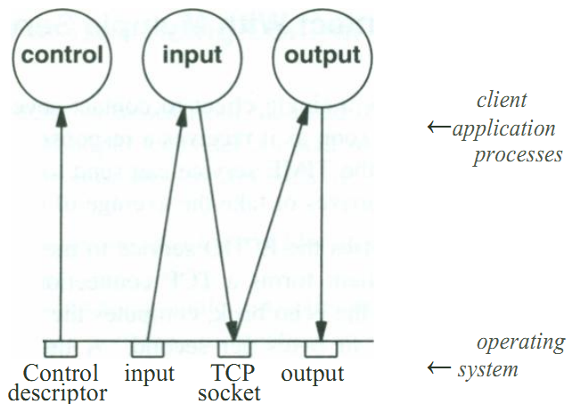
A Multi-Thread Concurrent Client
1. An input thread reads from standard input, formulates requests, and sends them to the server over the TCP connection.
2. A separate output thread receives responses from the server and writes them to standard output.
3. A third control thread accepts commands from the user that control processing.

Slide 7
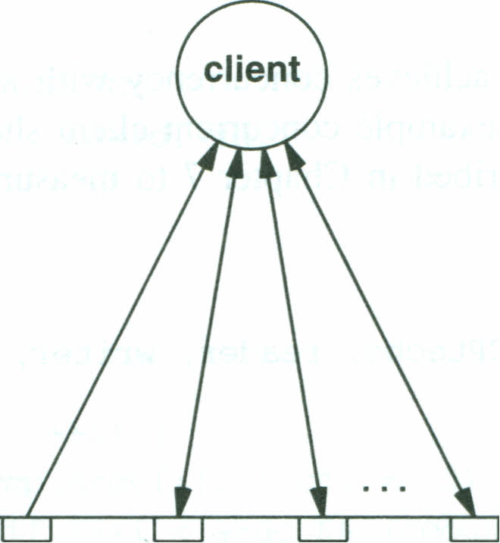
A Single Thread Concurrent Client
Client application process
input TCP TCP TCP
descriptor socket1 socket2 socketn
Operating system
A client can implement concurrency with a single thread algorithm.
The client uses select to handle multiple connections concurrently.

Slide 8
A Concurrent Echo Client
The concurrent client connects to multiple ECHO servers for measuring the network throughput to a set of machines
The client TCPtecho accepts multiple host names as arguments
  TCPtecho [ -c count ] host1 host2 ...
  For each host, it opens a TCP connection to the ECHO server
    It sends ccount bytes of “D” across the connection,
    reads the bytes it receives back from each server,
    and prints the total time required to complete the task
Therefore, the TCPtecho can be used to measure the current throughput to a set of machines

Slide 9
Two Major Advantages
The TCPtecho improves throughput measure in two ways:
  It obtains a more accurate measure of the time required for each connection because it measures the throughput on all connections during the same time interval.
    Thus, congestion affects all connections equally.
  It requires less total time to complete the whole task.
    When using a sequential client to measure N machines, it can take approximately N times longer than a concurrent version.
% ./TCPtecho-new linux1 linux2 linux3
linux1:2 ms
linux2:3 ms
linux3:3 ms
Total time elapsed: 3 ms
% ./TCPtecho-new -c 999999 linux1 linux2 linux3
linux2:32 ms
linux1:32 ms
linux3:33 ms
Total time elapsed: 33 ms

