Slide 1
IPS - HW3
Multi-Object Tracking

Slide 2
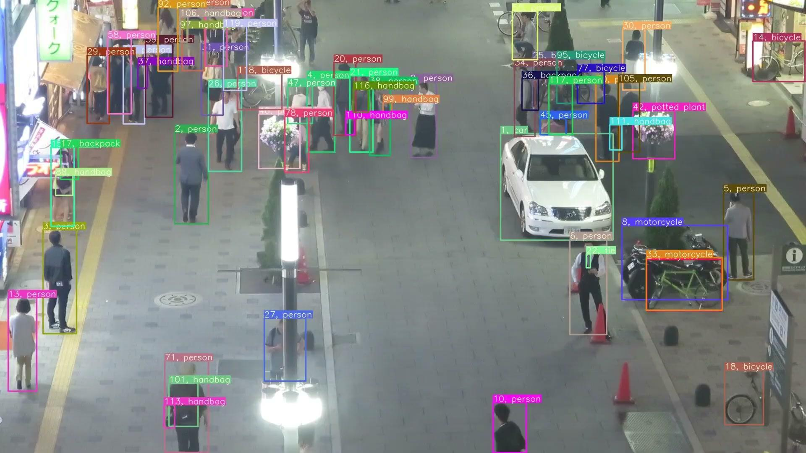
What is MOT?
Multi-Object Tracking (MOT) means:
  Detect and continuously track multiple objects in continuous images.
Main application scenarios:
  Self-driving cars, surveillance systems, motion analysis, video editing
BoT-SORT: Robust Associations Multi-Pedestrian Tracking
Nir Aharon, Roy Orfaig, Ben-Zion Bobrovsky
https://github.com/NirAharon/BoT-SORT

Slide 3
Types of MOT methods
Joint Detection and Tracking
VS.
Tracking-by-Detection

Slide 4
Joint Detection and Tracking
Basic Definition:
Combine "object detection" and "object tracking" into a single model to handle them simultaneously
Feature Sharing Architecture
Advantages: Theoretically high accuracy, can optimize both detection and tracking
Disadvantages: difficult to train, high data requirements

Slide 5
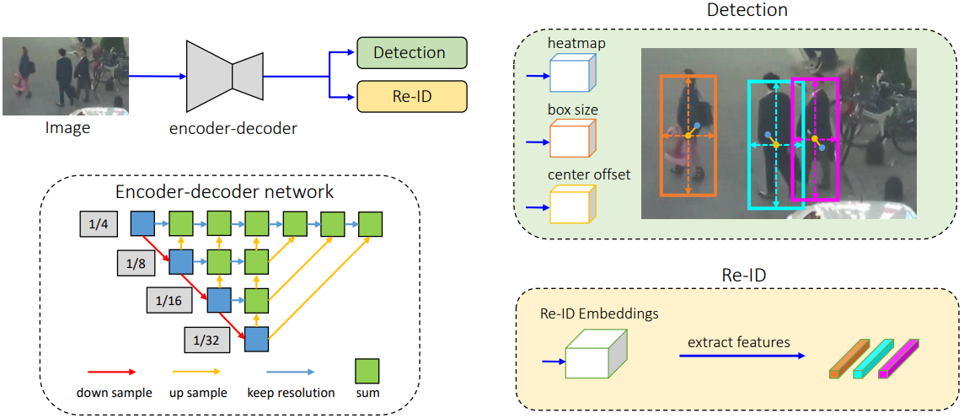
Joint Detection and Tracking
Single network, simultaneous detection and tracking
Detection branch: predicting center point and box size (anchor-free)
Re-ID branch: extracting target identity feature vector
Share feature maps to avoid interference between detection and tracking
Only extract center point features to reduce ID confusion
FairMOT: On the Fairness of Detection and Re-Identification in Multiple Object Tracking
Yifu Zhang1† · Chunyu Wang2† · Xinggang Wang1∗ · Wenjun Zeng2 · Wenyu Liu1
Shared Feature Map: Detection and Re-ID share a set of features
Anchor-free design: directly predict the center point to improve the detection rate of small objects
Re-ID embedding: Learn the identity vector of the object for association

Slide 6
Tracking-by-Detection
Basic Definition:
First use the detector to find the object in each frame
Then associate the detected objects into tracks on the timeline (Tracking)
Detection and tracking are designed separately
Advantages: modular, flexible, easy to deploy
Disadvantages: Detection quality determines tracking quality, easy to make mistakes in ID

Slide 7
Tracking-by-Detection
Pair new detections with existing tracks
IoU overlap ratio as distance metric
Hungarian Algorithm for best matching
New detection but no match → Create new ID
No match after a certain period of time → Delete ID
Object
Detection
Association tracking
Update
Status
ID
Management
Use off-the-shelf object detectors (YOLO, Faster R-CNN, etc.)
Extract bounding boxes (position information) per frame
Each tracker uses Kalman Filter to predict the next position
Update the prediction based on the new detected position

Slide 8
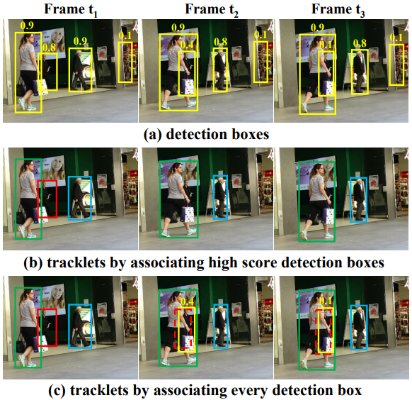
Tracking-by-Detection: ByteMOT
Input Frame
Detector (YOLOX)
Object Confideces
(score > thresh)
(score < thresh)
High confidence Association:
IoU + Hungarian Algorithm
Low confidence Association:
Associate for unpaired tracks
ByteTrack: Multi-Object Tracking by Associating Every Detection Box
Yifu Zhang, Peize Sun, Yi Jiang, Dongdong Yu, Fucheng Weng, Zehuan Yuan, Ping Luo, Wenyu Liu, Xinggang Wang
Update tracked trajectory + assign ID

Slide 9
Common technical tools
Kalman Filter: Predict the next frame position based on the motion model
Hungarian Algorithm: Optimally allocate detection frame and tracking frame
IoU: measures the degree of overlap between two boxes and is used as a basis for pairing
Re-ID: Enhanced recognition of objects with similar appearance

Slide 10

Common Evaluation Metrics
Metrics | Measurement Point | Explanation
HOTA | Overall Quality | Comprehensive Assessment Detection + Association + ID Consistency
IDF | Identity consistency | The same target maintain the same ID
MOTA | Overall accuracy | Including detection errors and ID switch
AssA | Association Accuracy | Determines whether the target matches the tracking ID correctly
DetA | Detection Accuracy | The ability to detect all correct targets
IDs | Number of ID errors | Number of times the target ID was mistakenly swapped or mixed up

