Slide 1
The Multiprotocol Servers
Shyan-Ming Yuan
CS Department, NCTU
smyuan@gmail.com

Slide 2
Motivations
In some situations, it is desirable to provide a service with different transport protocols.
  For example, the DAYTIME service support both TCP and UDP.
  Although single protocol servers are easy to maintain, but they may result in replicating the same piece of code to two different servers.
    This can lead to inconsistency of source codes.
  In addition, each single protocol server needs its own resource.
    This results in unnecessarily consuming process table entries and system resources.
Here, we present a simple multiprotocol DAYTIME server.
  It is an iterative server that supports both UDP and TCP.
  It uses the select() system call to switch among UDP and TCP sockets.

Slide 3
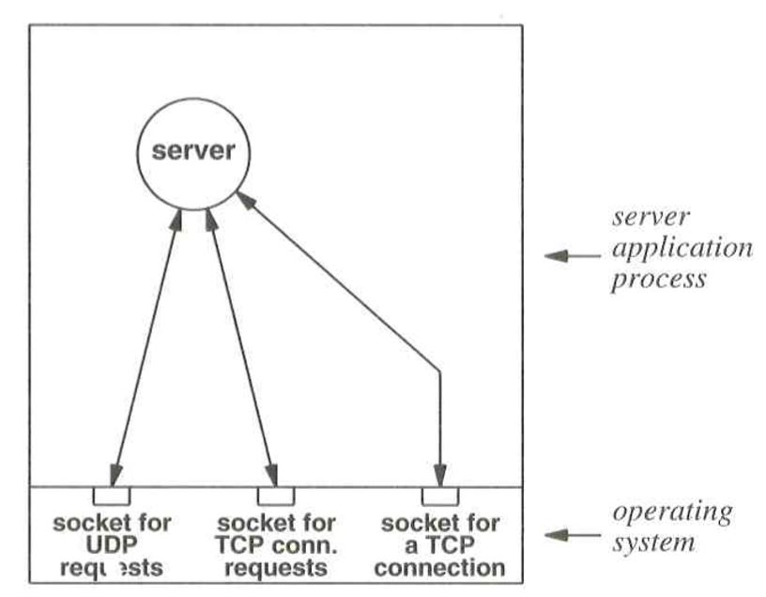
A Multiprotocol DAYTIME Server

Slide 4
A Multiprotocol DAYTIME Server
extern int errno;
extern int errexit(const char *format, …);
extern int passsiveTCP(const char *service, int qlen);
extern int paassiveUDP(const char *service);
Int daytime(char buf[]);
#define MAX (x, y) ((x)>(y)?(x):(y))
#define QLEN 32
#define LINELEN 128
int main(int argc, char *argv[])
{
char *service = "daytime"; /* service name or port number */
char buf[LINELEN+1]; /* buffer for one line of text */
struct sockaddr_in fsin; /* the request from address */
int alen; /* from-address length */
int tsock; /* TCP master socket */
int usock; /* UDP socket */
int nfds;
fd_set rfds; /* readable file descriptors */

Slide 5
A Multiprotocol DAYTIME Server
tsock = passiveTCP(service, QLEN);
usock = passiveUDP(service);
nfds = MAX(tsock, usock) + 1; /* bit number of max fd */
FD_ZERO(&rfds);
while (1) {
FD_SET(tsock, &rfds);
FD_SET(usock, &rfds);
if (select(nfds, &rfds, (fd_set *)0, (fd_set *)0, (struct timeval *)0) < 0)
errexit("select error: %s\n", strerror(errno));
if (FD_ISSET(tsock, &rfds)) {
int ssock; /* TCP slave socket */
alen = sizeof(fsin);
ssock = accept(tsock, (struct sockaddr *)&fsin, &alen);
if (ssock < 0) errexit("accept failed: %s\n", strerror(errno));
daytime(buf);
(void) write(ssock, buf, strlen(buf));
(void) close(ssock);
}

Slide 6
A Multiprotocol DAYTIME Server
if (FD_ISSET(usock, &rfds)) {
alen = sizeof(fsin);
if (recvfrom(usock, buf, sizeof(buf), 0, (struct sockaddr *)&fsin, &alen) < 0)
errexit("recvfrom: %s\n", strerror(errno));
daytime(buf);
(void) sendto(usock, buf, strlen(buf), 0, (struct sockaddr *)&fsin, sizeof(fsin));
}
}
}
int daytime(char buf[])
{
char *ctime();
time_t now;
(void) time(&now);
sprintf(buf, "%s", ctime(&now));
}

Slide 7
The DAYTIME clients
The TCPdaytime client
The UDPdaytime client

