Slide 1
The Multiservice Servers
Shyan-Ming Yuan
CS Department, NYCU
smyuan@gmail.com

Slide 2
Motivations
In general, it is desirable to merge multiple services into one server process.
  The same advantages of multiprotocol servers are also applied here.
    It can reduce the number of executing process.
    It only needs to maintain the codes that create and accepting connections in one place.
Multiservice Servers may have the following designs:
  Iterative Connectionless
  Iterative Connection-Oriented
  Concurrent Connection-Oriented

Slide 3
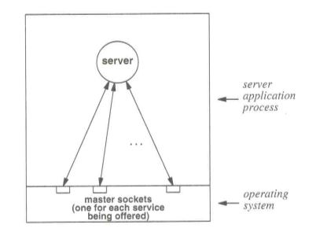
The Iterative UDP Multiservice Server
The server open a set of UDP sockets and binds each to a well-known port for a particular service.
  A table may be used to record the addresses of those service handle procedures.
  When a request datagram arrives, the server calls the corresponding procedure to handle the received request and reply the response.

Slide 4
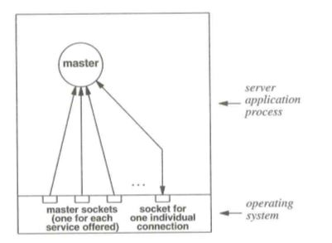
The Iterative TCP Multiservice Server

Slide 5
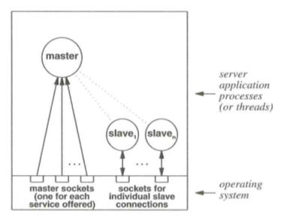
The Concurrent TCP Multiservice Server

Slide 6
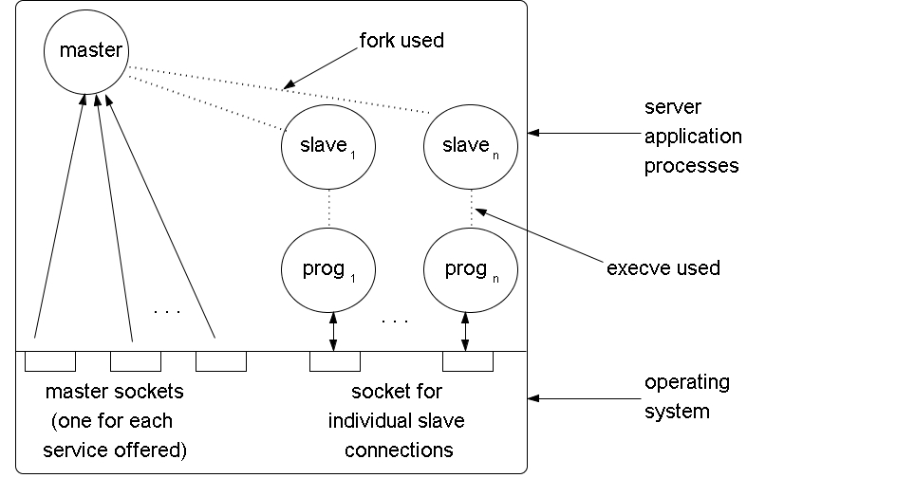
Concurrent TCP MSS with Separated Programs

Slide 7
A Multiprotocol Multiservice Server
Here we presents a simple MP-MS server that provide 4 simple services with 2 different protocols.
The following struct and service table is used to record protocols, sockets, and service handling functions.
struct service { char *sv_name;
char *sv_port;
char sv_useTCP;
int sv_sock;
void (*sv_func)(int);
};
struct service svent[] = {
{ "echo", "6001", TCP_SERV, NOSOCK, TCPechod },
{ "chargen", "6002", TCP_SERV, NOSOCK, TCPchargend },
{ "daytime", "6003", TCP_SERV, NOSOCK, TCPdaytimed },
{ "time", "6004", TCP_SERV, NOSOCK, TCPtimed },
{ "echo", "6005", UDP_SERV, NOSOCK, UDPechod },
{ 0, 0, 0, 0 },
};

Slide 8
A Multiprotocol Multiservice Server
Int main(int argc, char *argv[])
{ struct service *psv, /* service table pointer */ *fd2sv[NOFILE]; /* map fd to service pointer */
int fd, nfds;
fd_set afds, rfds; /* readable file descriptors */
switch (argc) {
case 1: break;
case 2: portbase = (unsigned short) atoi(argv[1]); break;
default: errexit("usage: superd [portbase]\n");
}
nfds = 0;
FD_ZERO(&afds);
for (psv = &svent[0]; psv->sv_name; ++psv) {
if (psv->sv_useTCP)
psv->sv_sock = passiveTCP(psv->sv_port, QLEN);
else psv->sv_sock = passiveUDP(psv->sv_port);
fd2sv[psv->sv_sock] = psv;
nfds = MAX(psv->sv_sock+1, nfds);
FD_SET(psv->sv_sock, &afds);
}

Slide 9
A Multiprotocol Multiservice Server
(void) signal(SIGCHLD, reaper);
while (1) {
memcpy(&rfds, &afds, sizeof(rfds));
if (select(nfds, &rfds, (fd_set *)0, (fd_set *)0, (struct timeval *)0) < 0) {
if (errno == EINTR) continue;
errexit("select error: %s\n", strerror(errno));
}
for (fd=0; fd<nfds; ++fd)
if (FD_ISSET(fd, &rfds)) {
psv = fd2sv[fd];
if (psv->sv_useTCP) doTCP(psv); else psv->sv_func(psv->sv_sock); }
}
}

Slide 10
A Multiprotocol Multiservice Server
void doTCP(struct service *psv)
{ struct sockaddr_in fsin; /* the request from address */ unsigned int alen; /* from-address length */ int fd, ssock;
alen = sizeof(fsin);
ssock = accept(psv->sv_sock, (struct sockaddr *)&fsin, &alen);
if (ssock < 0) errexit("accept: %s\n", strerror(errno));
switch (fork()) {
case 0: break;
case -1: errexit("fork: %s\n", strerror(errno));
default: (void) close(ssock);
return; /* parent */
} /* child */
for (fd = getdtablesize()-1; fd >= 0; --fd)
if (fd != ssock) (void) close(fd);
psv->sv_func(ssock);
exit(0);
}

Slide 11
A Multiprotocol Multiservice Server
void TCPdaytimed(int fd)
{ char buf[LINELEN], *ctime();
time_t now;
(void) time(&now);
sprintf(buf, "%s", ctime(&now));
(void) write(fd, buf, strlen(buf));
}
void TCPtimed(int fd)
{ time_t now;
(void) time(&now);
now = htonl((unsigned long)(now + UNIXEPOCH));
(void) write(fd, (char *)&now, sizeof(now));
}

Slide 12
A Multiprotocol Multiservice Server
void TCPchargend(int fd)
{ char c, buf[LINELEN+2]; /* print LINELEN chars + \r\n */ c = ' ';
buf[LINELEN] = '\r';
buf[LINELEN+1] = '\n';
while (1) {
int i;
for (i=0; i<LINELEN; ++i) {
buf[i] = c++;
if (c > '~') c = ' ';
}
if (write(fd, buf, LINELEN+2) < 0) break;
(void) sleep(5);
}
}

Slide 13
A Multiprotocol Multiservice Server
void TCPechod(int fd)
{ char buf[BUFFERSIZE];
int cc;
while (cc = read(fd, buf, sizeof buf)) {
if (cc < 0) errexit("echo read: %s\n", strerror(errno));
if (write(fd, buf, cc) < 0) errexit("echo write: %s\n", strerror(errno));
}
}
void UDPechod(int fd)
{ char buf[BUFFERSIZE]; /* buffer for one line of text */
struct sockaddr_in fsin; /* the request from address */ unsigned int alen; /* from-address length */
int n;
alen = sizeof(fsin);
if (n=recvfrom(fd, buf, sizeof(buf), 0, (struct sockaddr *)&fsin, &alen) < 0) errexit("recvfrom: %s\n", strerror(errno));
buf[n]='\0'; // null termination
(void) sendto(fd, buf, strlen(buf), 0, (struct sockaddr *)&fsin, sizeof(fsin));
}

Slide 14
Using Separate Programs
To improve the maintainability and readability, we can replace TCP services by separate programs.
  “./TCPechod”, “./TCPchagend”, “./DTd”, “./TCPtimed”
struct service svent[] =
{ { "echo", "6001", TCP_SERV, NOSOCK, 0, "./TCPechod" },
{ "chargen", "6002", TCP_SERV, NOSOCK, 0, "./TCPchargend" },
{ "daytime", "6003", TCP_SERV, NOSOCK, 0, "./DTd" },
{ "time", "6004", TCP_SERV, NOSOCK, 0, "./TCPtimed" },
{ "echo", "6005", UDP_SERV, NOSOCK, UDPechod, 0 },
{ 0, 0, 0, 0, 0, 0 },
};

Slide 15
The modified main()
Int main(int argc, char *argv[])
{ struct service *psv; /* service table pointer */
int fd, nfds;
fd_set afds, rfds; /* readable file descriptors */
nfds = 0;
FD_ZERO(&afds);
for (psv = &svent[0]; psv->sv_name; ++psv) {
if (psv->sv_useTCP)
psv->sv_sock = passiveTCP(psv->sv_port, QLEN);
else
psv->sv_sock = passiveUDP(psv->sv_port);
nfds = MAX(psv->sv_sock+1, nfds);
FD_SET(psv->sv_sock, &afds);
}
(void) signal(SIGCHLD, reaper);

Slide 16
The modified main()
while (1) {
memcpy(&rfds, &afds, sizeof(rfds));
if (select(nfds, &rfds, (fd_set *)0, (fd_set *)0, (struct timeval *)0) < 0) {
if (errno == EINTR)
continue;
errexit("select error: %s\n", strerror(errno));
}
for (psv = &svent[0]; psv->sv_name; ++psv)
if (FD_ISSET(psv->sv_sock, &rfds)) {
if (psv->sv_useTCP)
doTCP(psv);
else
psv->sv_func(psv->sv_sock);
}
}
}

Slide 17
The doTCP()
Void doTCP(struct service *psv)
{ struct sockaddr_in fsin; /* the request from address */
unsigned int alen; /* from-address length */
int fd, ssock;
alen = sizeof(fsin);
ssock = accept(psv->sv_sock, (struct sockaddr *)&fsin, &alen);
if (ssock < 0) errexit("accept: %s\n", strerror(errno));
switch (fork()) {
case 0: break;
case -1: errexit("fork: %s\n", strerror(errno));
default: (void) close(ssock);
return; /* parent */
} /* child */
dup2(ssock, 1); dup2(ssock, 0);
for (fd = getdtablesize()-1; fd >= 2; --fd) /* close all unused fds */
(void) close(fd);
execl(psv->sv_prog,psv->sv_prog, NULL);
exit(-1);
}

Slide 18
The Separated TCP service programs
The TCPchargend.c
The TCPechod.c
The TCPtimed.c
The TCPdaytimed.c

Slide 19
Reconfiguration & Versioning
In order to reconfigure the supported services and/or deploy new service programs, one can use a configuration file to maintain the information about supported services.
  In addition, a special reconfigure service is added to change the configuration and install new services without shut down the server.
The configuration file contains the following records.
echo 6101 UDP ./UDPmpechod
chargen 6102 TCP ./TCPchargend
echo 6105 UDP ./UDPitechod
daytime 6103 TCP ./DTd
echo 6106 TCP ./TCPechod
time 6104 TCP ./TCPtimed

Slide 20
The new main()
char *filename = "./configuration";
char *reconf = "6000"; /* reconfiguration service port */
Int main(int argc, char *argv[])
{ struct service *psv; /* service table pointer */
int cmd_sock; /* the reconfiguration service socket*/
int i, n;
fd_set rfds; /* readable file descriptors */
cmd_sock = passiveUDP(reconf);
n = doSETUP(cmd_sock);
(void) signal(SIGCHLD, reaper);
while (1) { memcpy(&rfds, &afds, sizeof(rfds));
if (select(nfds, &rfds, (fd_set *)0, (fd_set *)0, (struct timeval *)0) < 0) {
if (errno == EINTR) continue;
errexit("select error: %s\n", strerror(errno));
}

Slide 21
The new main()
for (i=0; i<n; i++) {
psv = svent[i];
if (FD_ISSET(psv->sv_sock, &rfds)) {
if (psv->sv_useTCP) doTCP(psv); // same as the old one
else doUDP(psv); // new for all UDP services
}
}
if (FD_ISSET(cmd_sock, &rfds)) {
for (i=0; i<n; i++) { // close all other TCP & UDP sockets
psv = svent[i];
close(psv->sv_sock);
free (psv);
}
n = doSETUP(cmd_sock); // re-setup
UDPconfd(cmd_sock);
}
}
}

Slide 22
The doSETUP()
Int doSETUP(int fd)
{ struct service *psv; /* service table pointer */
char svname[20], svport[10], svTCP[10], svprog[20];
FILE *file;
int n;
FD_ZERO(&afds); nfds = fd+1; FD_SET(fd, &afds);
file = fopen(filename, “r");
n=0;
while (fscanf(file, "%s %s %s %s\n", svname, svport, svTCP, svprog)!= EOF) {
printf("%s %s %s %s\n", svname, svport, svTCP, svprog);
psv = (struct service *) malloc(sizeof (struct service));
memcpy(psv->sv_name, svname, sizeof(svname));
memcpy(psv->sv_port, svport, sizeof(svport));
if (strcmp(svTCP, "TCP")==0) {
psv->sv_useTCP = TCP_SERV;
psv->sv_sock = passiveTCP(psv->sv_port, QLEN);
} else { psv->sv_useTCP = UDP_SERV;
psv->sv_sock = passiveUDP(psv->sv_port);
}
memcpy(psv->sv_prog, svprog, sizeof(svprog));
nfds = MAX(psv->sv_sock+1, nfds);
FD_SET(psv->sv_sock, &afds);
svent[n++] = psv;
if (n==MAX_SERVICE) break;
}
(void) fclose(file);
return n;
}

Slide 23
The UDPconfd()
void UDPconfd(int fd)
{ char buf[BUFFERSIZE]; /* buffer for one line of text */
struct sockaddr_in fsin; /* the request from address */
unsigned int alen; /* from-address length */
int n;
alen = sizeof(fsin);
bzero(buf, sizeof(buf));
if (n=recvfrom(fd, buf, sizeof(buf), 0, (struct sockaddr *)&fsin, &alen) < 0)
errexit("recvfrom: %s\n", strerror(errno));
printf("Request for reconfiguration is received!!\n");
sprintf(buf, "Reconfiguration was completed !!\n");
(void) sendto(fd, buf, strlen(buf), 0, (struct sockaddr *)&fsin, sizeof(fsin));
}

Slide 24
The doUDP()
Void doUDP(struct service *psv)
{ int fd;
switch (fork()) {
case 0: break;
case -1: errexit("fork: %s\n", strerror(errno));
default:
FD_CLR(psv->sv_sock, &afds);
return; /* parent */
}
/* child */
dup2(psv->sv_sock, 1);
dup2(psv->sv_sock, 0);
for (fd = getdtablesize()-1; fd >= 2; --fd) /* close all unused fds */
(void) close(fd);
execl(psv->sv_prog, psv->sv_prog, NULL);
exit(-1);
}

Slide 25
The Separated UDP service program
The UDPitechod.c
The UDPmpechod.c

