Slide 1
POSIX Multi-Thread Programming
Shyan-Ming Yuan
CS Department, NCTU
smyuan@gmail.com

Slide 2
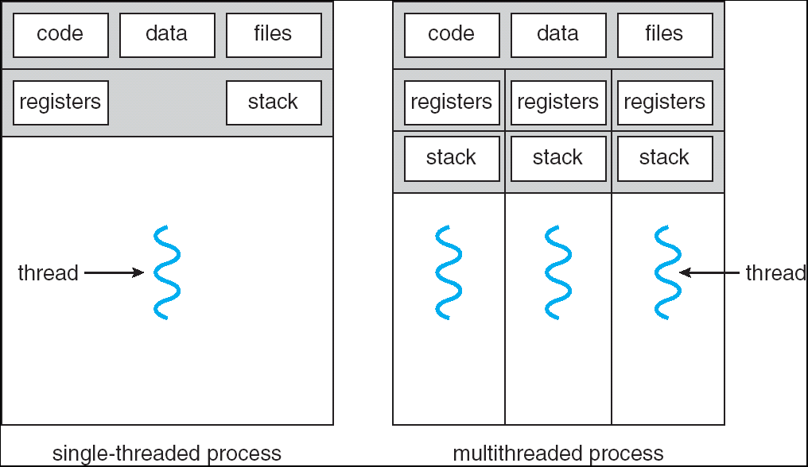
Single & Multi-Threaded Processes

Slide 3
The POSIX pthread Example
int sum, total; /* shared by all thread(s) */
void *runner(void *param); /* the child threads’ entry point */
main(int argc, char *argv[]){ /* the main thread */
pthread_t tid; /* the thread identifier */
pthread_attr_t attr; /* set of attributes for the thread */
pthread_attr_init (&attr); /* get the default attributes */
pthread_create (&tid, &attr, runner, argv[1]); /* create a child thread */
// codes for the main thread
total = 0;
lower = atoi (argv[1]);
for (i=lower+1; i<=lower+10; i++) {
total += i;
printf ("The value of i in main thread %ld is %d\n", (unsigned long) pthread_self(), i);
usleep (10);
};
pthread_join(tid, NULL); /* wait for the child thread to complete */
printf ("The sum from %d to %d in main thread %ld is %d\n",
lower+1, lower+10, (unsigned long) pthread_self(), total);
total += sum;
printf ("total in main thread %ld is %d\n", (unsigned long) pthread_self(), total);
}

Slide 4
The POSIX pthread Example
void *runner(void *param) { /* codes for child thread */
int upper = atoi (param);
int i;
sum = 0;
if (upper <= 0) pthread_exit(&upper);
for (i=1; i<=upper; i++) {
printf ("The value of i in child thread %ld is %d\n", (unsigned long) pthread_self(), i);
sum += i;
usleep (10);
};
printf ("The sum from 1 to %d in child thread %ld is %d\n", upper,
(unsigned long) pthread_self(), sum);
pthread_exit(0);
}

Slide 5
POSIX Threads
The simple example for concurrent threads: sum2t.c
  The possible output
The example of using multiple child threads:
  sumthread.c and it's output

Slide 6
Thread Creation & Termination
Functions for thread life cycle management are:
  pthread_attr_init(): attributes initialization
  pthread_create(): new thread creation
  pthread_join(): waiting for thread termination
  pthread_exit(): terminating the calling thread
  pthread_cancel(): terminating a target thread
All pthread functions must be compiled and linked with
  -pthread option.

Slide 7
The pthread_attr functions
The pthread_attr_init() initializes the thread attributes object with default attribute values.
The pthread_attr_destroy() destroy a thread attributes object when it is no longer required.
  On success, they return 0
  On error, they return a nonzero error number.
The thread attributes object can then be used to create new threads.
#include <pthread.h>
int pthread_attr_init (pthread_attr_t *attr);
int pthread_attr_destroy (pthread_attr_t *attr);

Slide 8
The pthread_create ()
The pthread_create () starts a new thread in the calling process.
  The new thread starts execution by invoking the start_routine ().
  The arg is passed as the sole argument of the start_routine().
  The new thread can be terminated by three ways:
    It calls pthread_exit () with an exit status which can be obtained by any thread in the same process that calls pthread_join ().
    It returns from the start_routine.
    It is canceled by other thread calling the pthread_cancel () function.
  Any of the threads in the process calls exit (), or the main thread performs a return from main () will terminate the whole process.
#include <pthread.h>
int pthread_create (pthread_t *thread, const pthread_attr_t *attr,
void *(*start_routine) (void *), void *arg);

Slide 9
The pthread_exit ()
The pthread_exit () terminates the calling thread and returns an exit status (if the thread is joinable) to the pthread_join () called by any thread in the same process.
  Any clean-up handlers established by pthread_cleanup_push() that have not yet been popped, are popped (in the reverse of the order in which they were pushed) and executed.
  If the thread has any thread-specific data, then, after the clean-up handlers have been executed, the corresponding destructor functions are called, in an unspecified order.
#include <pthread.h>
void pthread_exit(void *retval);

Slide 10
The pthread_join ()
The pthread_join () function waits for a specified thread (it must be joinable) to terminate.
  If the target thread has already terminated, then pthread_join () returns immediately.
    Otherwise, it will be blocked until the target thread terminates.
  On success, pthread_join () returns 0
  On error, it returns an error number.
#include <pthread.h>
int pthread_join(pthread_t thread, void **retval);

Slide 11
The pthread_cancel ()
The pthread_cancel() sends a cancellation to the specified thread.
The target thread reacts to the cancellation request depends on it`s two attributes: cancel state and cancel type.
  A thread‘s cancel state can be set by pthread_setcancelstate ().
    enabled (the default for new threads) or disabled.
  If a thread has enabled cancel state, then its cancel type determines when cancellation occurs.
  A thread‘s cancel type can be set by pthread_setcanceltype ().
    asynchronous or deferred (the default for new threads).
#include <pthread.h>
Int pthread_cancel(pthread_t thread);

Slide 12
Some useful pthread functions
pthread_self () returns the pthread ID of the calling thread.
pthread_equal () compares two pthread IDs.
  If the two pthread IDs are equal,
    it returns a nonzero value,
    otherwise, it returns 0.
#include <pthread.h>
pthread_t pthread_self (void);
int pthread_equal (pthread_t t1, pthread_t t2);

Slide 13
Thread Synchronizations
Concurrent threads may need to synchronize with each other for accessing shared resources.
In Posix, there are 3 synchronization mechanisms:
  Mutex: a special variable for providing mutally exclusive access to a shared data item.
  Condition variable: a special object for providing mutually exclusive access to a shared data item with condition.
    It allows a thread to acquire a shared data and wait for a particular condition to occur in the same time.
  Semaphore: a generalized mutex object which can permit up to N threads to access the shared data in the same time.

Slide 14
The pthread_mutex Functions
pthread_mutex_init() initializes a mutex object.
  If attr is NULL, the default attributes are used.
  Upon successful initialization, the state of the mutex variable becomes initialized and unlocked.
pthread_mutex_destroy() destroys an unlocked mutex.
  A destroyed mutex object can be reinitialized by pthread_mutex_init().
Only mutex objects can be used for the synchronization functions.
    pthread_mutex_lock (), pthread_mutex_trylock (), pthread_mutex_unlock ()
#include <pthread.h>
int pthread_mutex_destroy (pthread_mutex_t *mutex);
Int pthread_mutex_init (pthread_mutex_t *restrict mutex,
const pthread_mutexattr_t *restrict attr);

Slide 15
The mutex lock functions
The mutex object can be locked by calling pthread_mutex_lock ().
  If the mutex is already locked, the calling thread blocks until the mutex becomes available.
  The pthread_mutex_trylock () can also lock a mutex object, except that if the mutex is currently locked then the call returns immediately.
  The pthread_mutex_unlock () releases the mutex from the calling thread.
#include <pthread.h>
int pthread_mutex_lock (pthread_mutex_t *mutex);
int pthread_mutex_trylock (pthread_mutex_t *mutex);
int pthread_mutex_unlock (pthread_mutex_t *mutex);

Slide 16
The pthread_cond functions
pthread_cond_init () initializes a condition variable.
  If attr is NULL, the default attributes are used.
pthread_cond_destroy () destroys the given condition variable.
  A destroyed condition variable can be reinitialized by calling pthread_cond_init ().
#include <pthread.h>
int pthread_cond_destroy (pthread_cond_t *cond);
int pthread_cond_init (pthread_cond_t *restrict cond,
const pthread_condattr_t *restrict attr);

Slide 17
The pthread_cond operations
A thread locks a mutex can use pthread_cond_wait() to block on a condition variable.
  It atomically releases the original locked mutex and cause the calling thread to block on the condition variable.
pthread_cond_signal() unblocks at least one of the threads that are blocked on the condition variable.
pthread_cond_broadcast() unblocks all threads currently blocked on the condition variable.
#include <pthread.h>
int pthread_cond_wait (pthread_cond_t *restrict cond,
pthread_mutex_t *restrict mutex);
int pthread_cond_broadcast (pthread_cond_t *cond);
int pthread_cond_signal (pthread_cond_t *cond);

Slide 18
The Producer Consumer Problem
A typical paradigm for cooperating applications.
  Producers produce information that can be consumed by consumers
  Items are placed in a shared stack
    A producer can push a new item into the stack
    A consumer can get an item from the stack
Solution-1: a mutex is used for coordinating threads for the access to the shared stack
  Here is the possible output
Solution-2: a mutex and 2 condition variables are used
  Here is the possible output

Slide 19
The Shared Stack in a MT Process
Producer-1
Item
Item
Consumer-1
Thread P1
Producer-2
Thread C1
Item
Thread P2
Item
Consumer-2
Producer-3
Item
Thread C2
Thread P3
mutex
Shared
Stack

